Slide 1
Welcome to year 2!

Slide 2

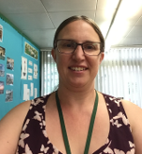
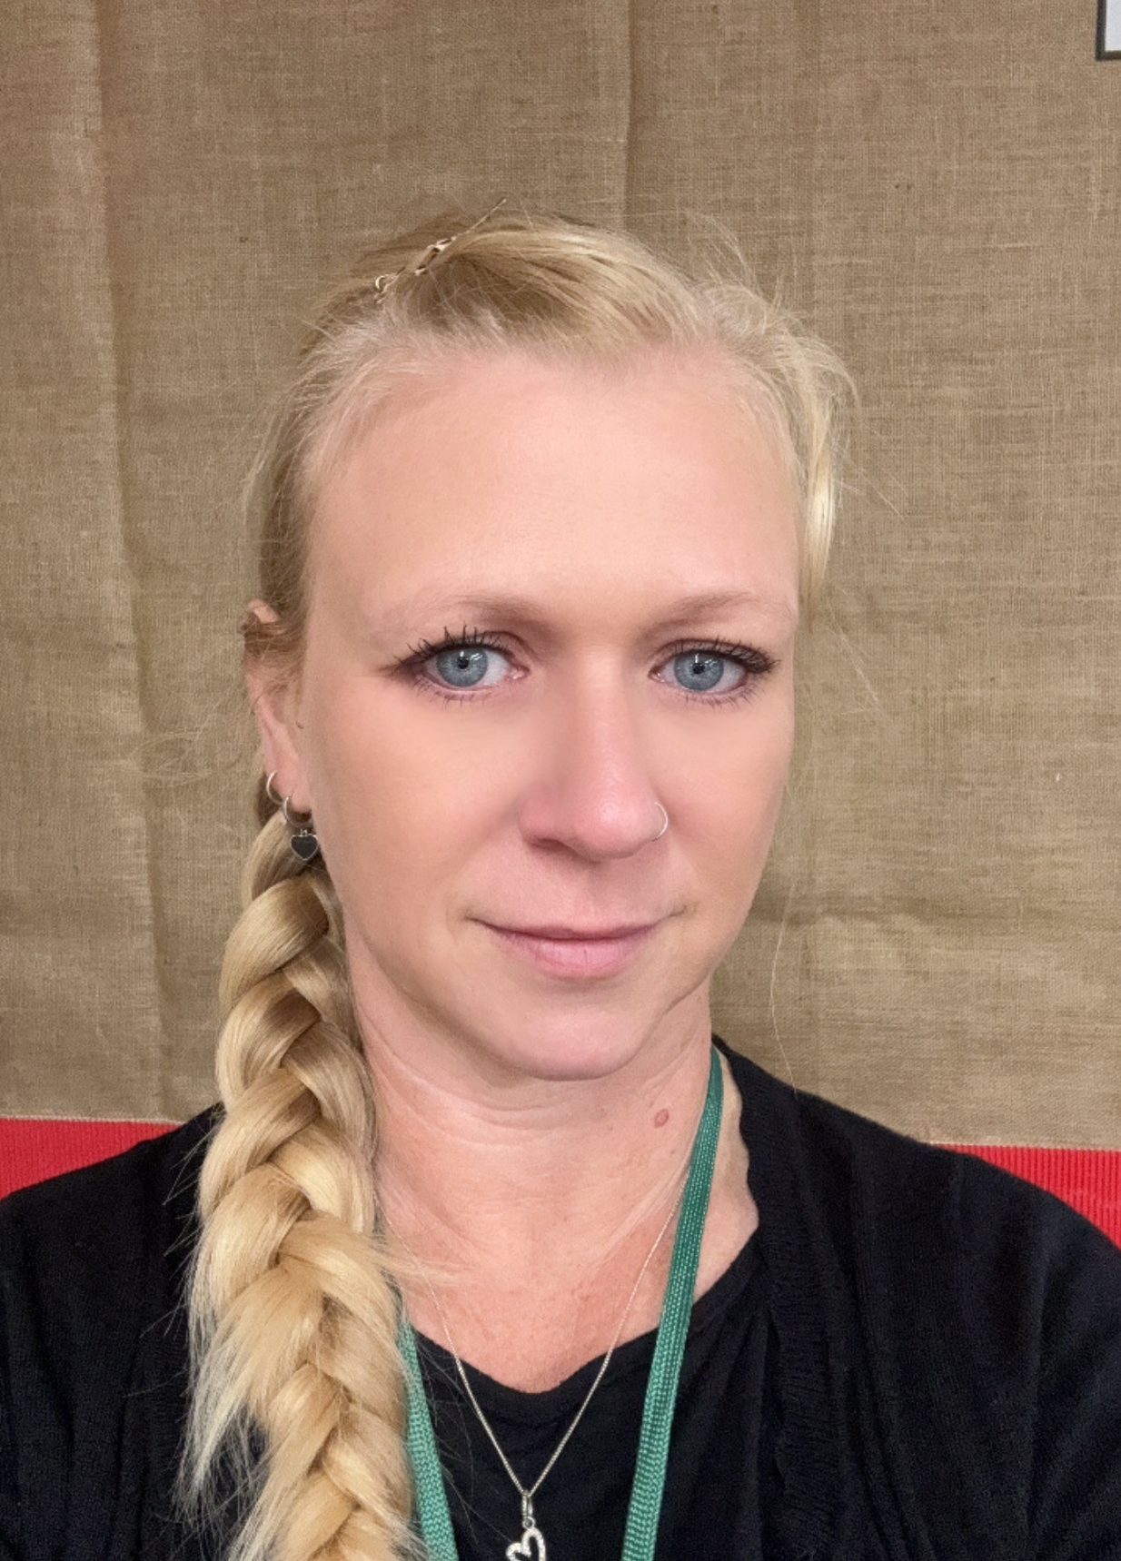
Our team
Mrs Montague (Teacher) – 2M
Miss Lee(LSA) – 2M
Mrs Blanchette (HLTA cover on Friday afternoons)
Miss Gook (Teacher) – 2G
Miss White (LSA) – 2G
Mrs Hayter (LSA/HLTA cover on Friday afternoons) – 2M/2G

Slide 3
Important Dates/days
PE is on Tuesdays and Wednesdays – thanks to all who have been sending children in PE kits!
Homework is set on a Monday, and then collected the following Monday.
Books can be changed on a Friday.

Slide 4
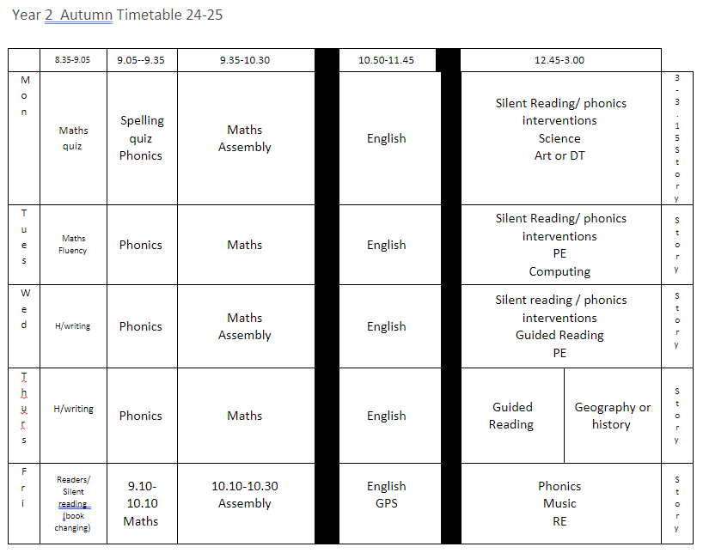
Timetable

Slide 5
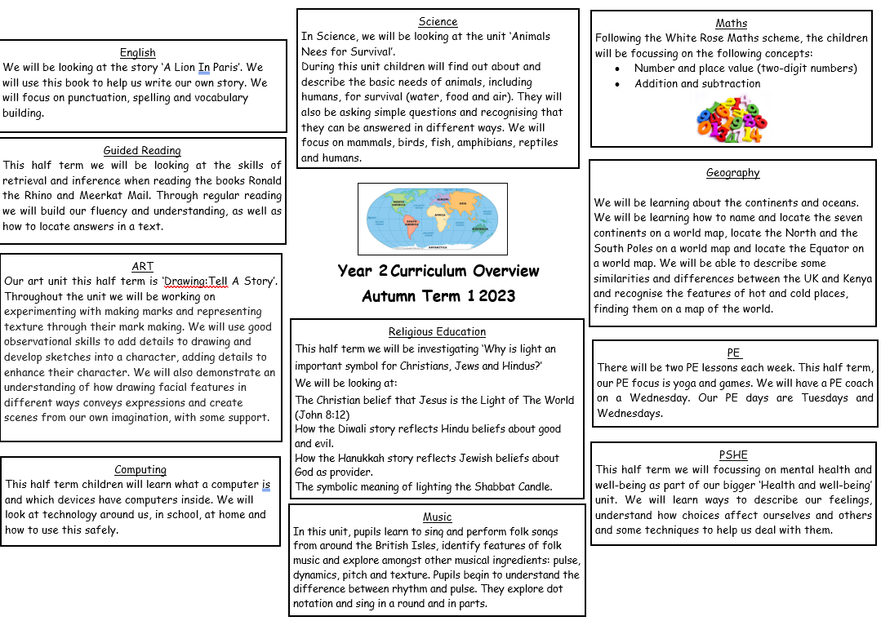

Slide 6
REading
Please try to read with your child at least 4 times a week.
The books are based on their current phonics level and will contain sounds from that level.
We recommend reading the book at least 4 times through before changing it – this allows for decoding, understanding and fluency.
There are questions in the back of the book to ask to check understanding – please be aware that reading tests in school test understanding, so this is an important skill to work on at home too.

Slide 7
Maths homework
Homework will be sent home in homework books.
It will be based on something the children have already learnt in class to give them extra practice.

Slide 8
Spellings
Each week spelling homework will be stuck into the yellow book. This should be practised on paper or in another place.
The spellings are based on the words we are learning each week in phonics, however different groups will have different spellings, so please don’t panic if spellings are different to their friends!
A spelling quiz on a Monday will be recorded in the back of the yellow books for you to check their score.

Slide 9
GPS
GPS homework will be sent home weekly and will reflect the learning they have done in class. This will be on a sheet to be completed and then returned on the following Monday.

Slide 10
A few important messages
Please continue to ensure that your child has a water bottle that they can fill throughout the day.
Please make sure that earrings are removed prior to coming to school on PE days.
No other jewellery should be worn (unless for religious purposes - agreed by class teacher).
Thank you for not sending in fiddle toys or plush toys this year, it has saved us a lot of nagging!

Slide 11

A small plea
If you have any old shirts/t-shirts that you don’t mind getting dirty, please can you send your child in with it to use as an art apron, as we plan on using lots of different media this year and it might get a bit messy.
If you have more than one, these will be gratefully received as spares for those that don’t have any!

